Slide 1
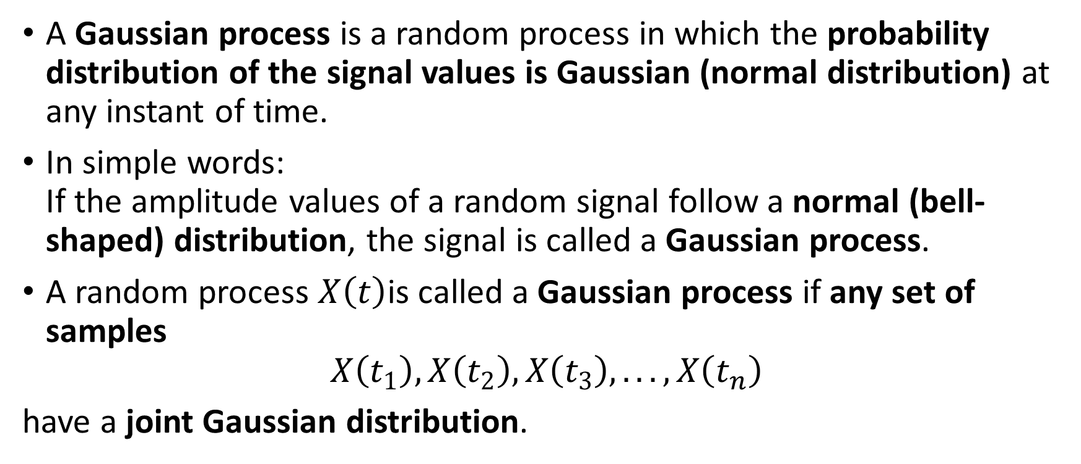
GAUSSIAN PROCESS
A Gaussian process is a random process in which the probability distribution of the signal values is Gaussian (normal distribution) at any instant of time.
In simple words: If the amplitude values of a random signal follow a normal (bell-shaped) distribution, the signal is called a Gaussian process.
A random process $X\left(t\right)$is called a Gaussian process if any set of samples
$$X\left(t_{1}\right),X\left(t_{2}\right),X\left(t_{3}\right),...,X\left(t_{n}\right)$$
have a joint Gaussian distribution.

Slide 2
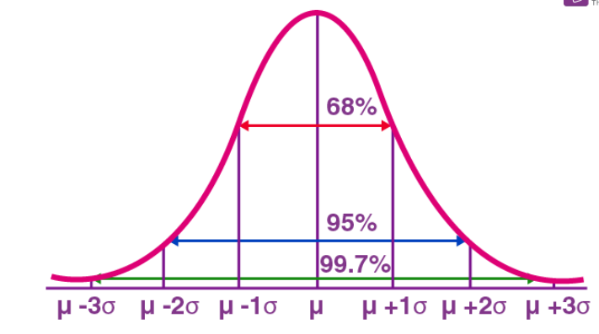

The Gaussian distribution is given by
$p\left(x\right)=\frac{1}{\sqrt{2πσ^{2}}}e^{−\frac{\left(x−μ{\left.)\right.}^{2}\right.}{2σ^{2}}}$
Where:
$μ$= Mean value
$σ^{2}$= Variance
$σ$= Standard deviation

Slide 3
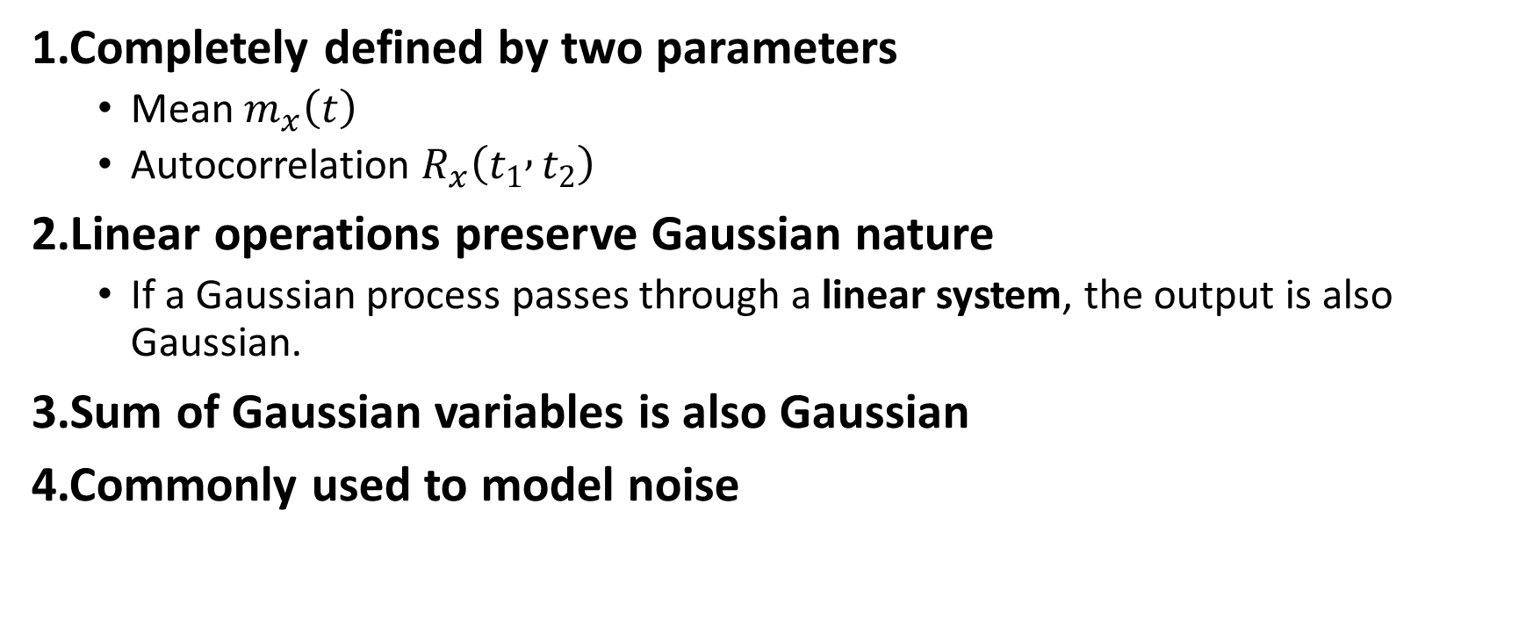
Properties of Gaussian Process
1.Completely defined by two parameters
Mean $m_{x}\left(t\right)$
Autocorrelation $R_{x}\left(t_{1} , t_{2}\right)$
2.Linear operations preserve Gaussian nature
If a Gaussian process passes through a linear system, the output is also Gaussian.
3.Sum of Gaussian variables is also Gaussian
4.Commonly used to model noise

Slide 4
In a normal distribution, the mean, median and mode are equal.(i.e., Mean = Median= Mode).
The total area under the curve should be equal to 1.
The normally distributed curve should be symmetric at the centre.
There should be exactly half of the values are to the right of the centre and exactly half of the values are to the left of the centre.
The normal distribution should be defined by the mean and standard deviation.
The normal distribution curve must have only one peak. (i.e., Unimodal)
The curve approaches the x-axis, but it never touches, and it extends farther away from the mean.

Slide 5
The most common example is:
White Gaussian Noise (WGN)
Noise in communication systems is often assumed to be:
White → equal power at all frequencies
Gaussian → amplitude follows Gaussian distribution

Slide 6
A Gaussian process means the amplitude of noise follows a Gaussian (normal) distribution.
If you measure the noise voltage many times, the values will form a bell-shaped curve.
White noise means the noise power is the same at all frequencies.
White noise → describes how noise power is spread over frequency.
Thermal noise has two properties:
Power is independent of frequency → White noise
Amplitude follows Gaussian distribution → Gaussian process

Slide 7
Thermal noise is modeled as white Gaussian noise because its power spectral density is constant over frequency (white) and its amplitude distribution follows Gaussian statistics.

